Slide 1



Creating Rural Entrepreneurship
Redefining Governance

Slide 2

There was a time when

Slide 3
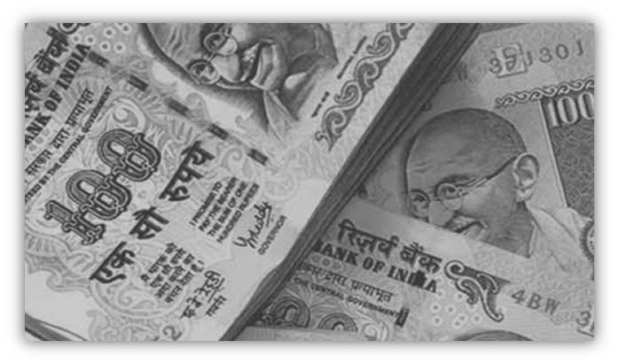

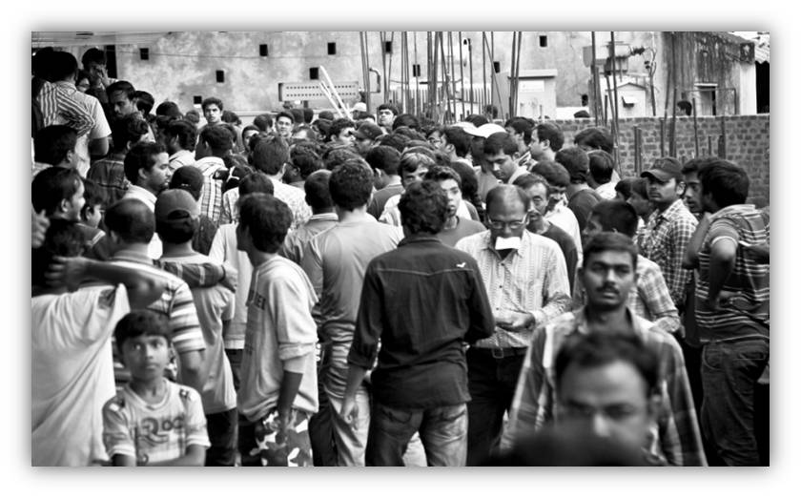

people lost there faith on governance system because of the hardship they had to endure
Expenses
inconvenience
multiple visits
Demotivating
Even the officials , esp. the dedicated and the hardworking ones Found
the response Demotivating ever after putting in their best efforts

Slide 4
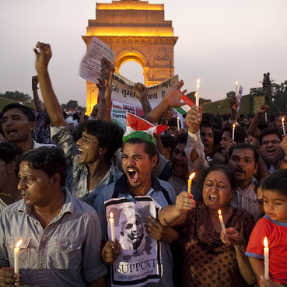
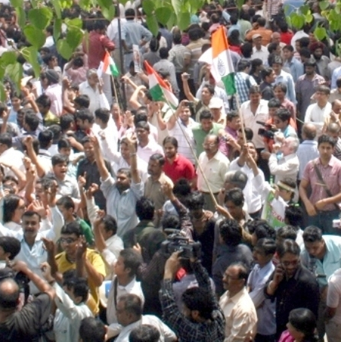
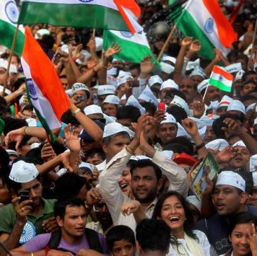
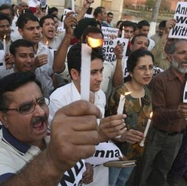
People wanted more from the chosen government
04
The Rising Demand
Criticism that the Govt is working on utopian concepts
03
Wants transformed into Needs exposed in the form of Cries began echoing finally Resonating
02
01
Campaigns and Movements
Anti corruption movement

Slide 5

And then came a silent revolution in rural entrepreneurship
Redefining governance

Slide 6

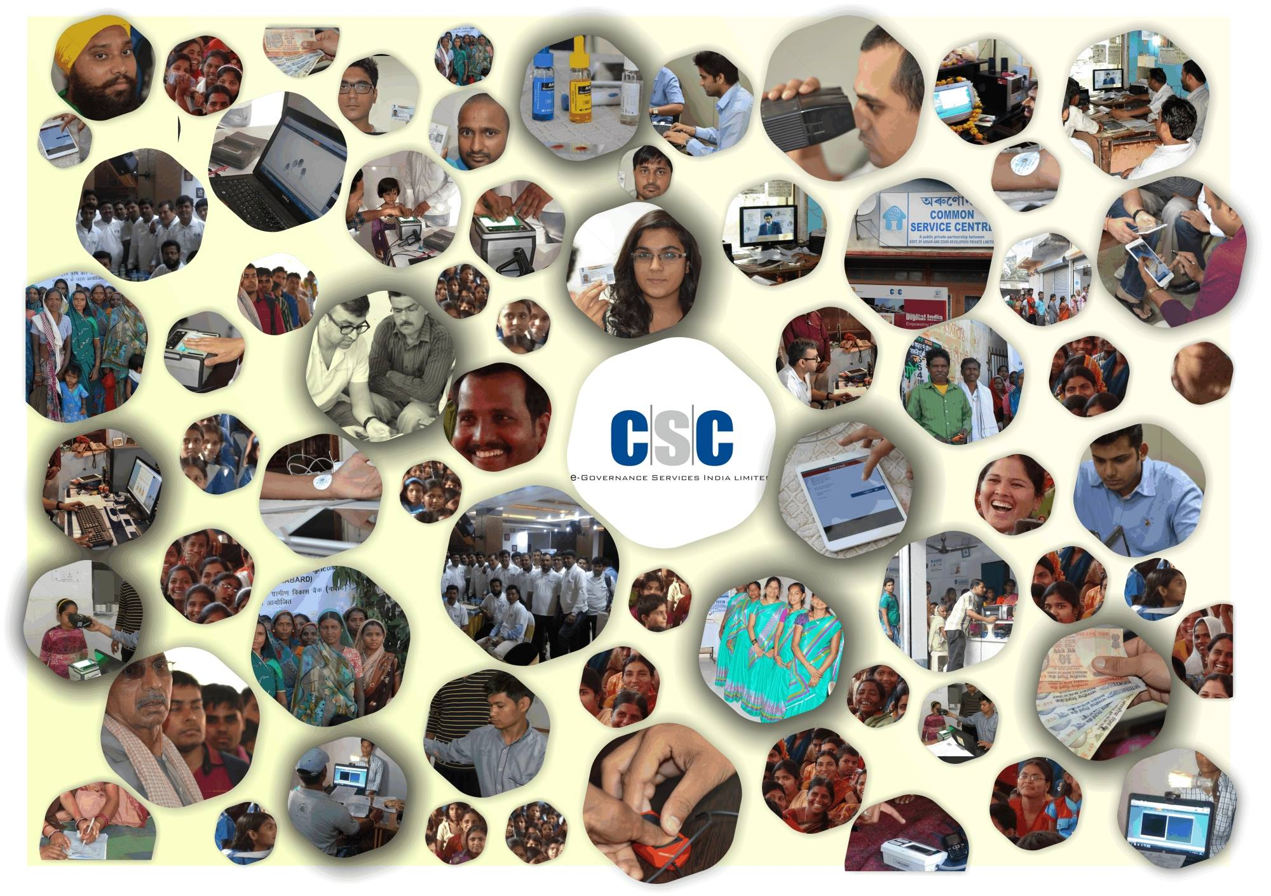
And Finally a solution emerged
A one stop shop for every problem a citizen had
Common Services Centers (CSC) (Hindi: सर्व सेवा केंद्र) are multiple-services-single-point model for providing facilities for multiple transactions at a single geographical location
Notes:
Don’t forget to add a background image and send it backward.

Slide 7

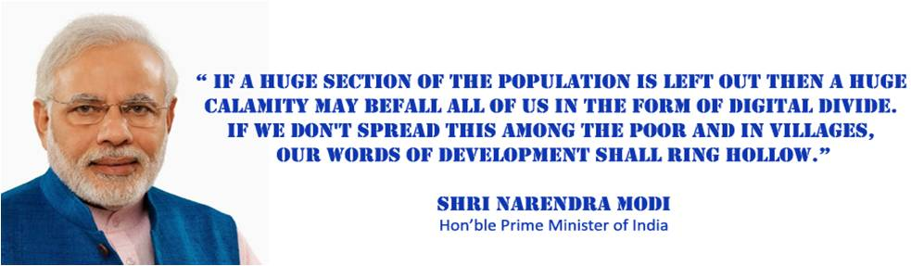
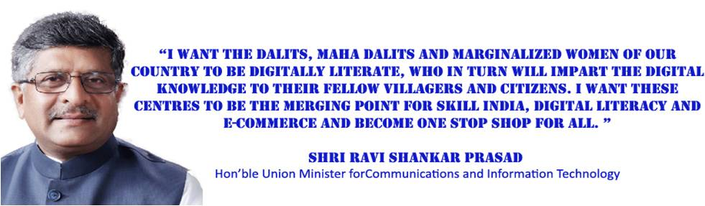
Vision & Mission
01
Hon’ble Prime Minister
Shri Narendra Modi
02
Hon’ble Union Minister
Shri Ravi Shankar Prasad

Slide 8

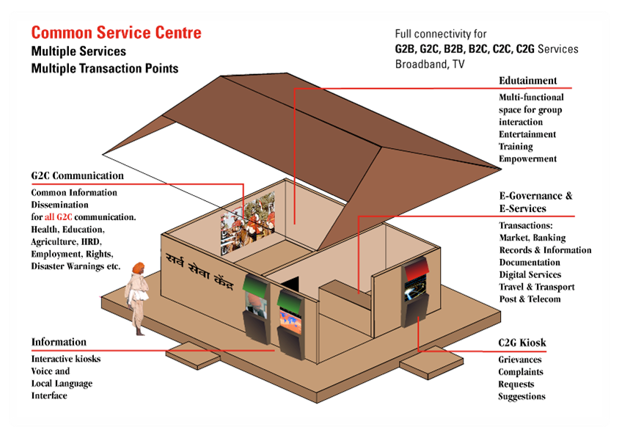
Notes:
Choose Format -> Send Backward if your image is over lapping the mobile phone. You might need to click it several times to get it where you need it to be.

Slide 9





User convenience
01
06
Eliminated Multiple Visits
User Friendly
02
05
Convenience of time and location
Cost Effective
03
04
Transparent and Simple
Across the counter services
Notes:
Don’t forget to add a backroung a image and send it backward.

Slide 10




Common Services center
Common Services Centers (CSCs) are a strategic cornerstone of the Digital India programme. They are the access points for delivery of various electronic services to villages in India, thereby contributing to a digitally and financially inclusive society.
CSCs enable the three vision areas of the Digital India programme:
STATE DATA CENTRE
STATE WIDE AREA NETWORK
(SWAN)
COMMON SERVICE CENTER
csc
3 INFRASTRUCTURE PILLARS OF
NATIONAL EGOVERNANCE PLAN
CSC is front-end delivery points for Govt, pvt & social sector services to rural citizens of India
Expansion of CSC service area to urban regions on a pan-India basis.
CSC scheme to provide front-end delivery points for Government, private and social sector services

Slide 11


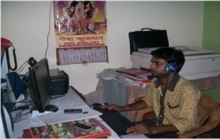

Govt. Service Delivery Mechanism
STATE PORTAL
State Data Centre
REGISTRATION
Citizens can access services through Internet
TRANSPORT
Internet
MUNICIPALITIES
.
.
.
.
.
.
.
SHQ
Collector’s Office
UIDAI
Application Layer
Tehsil / Taluks
Govt. Deptts & Ministeries (including
Sub-ordinate offices)
Rural / Urban users can use services through CSC Centres
Common Service Centres (CSC)
Village Level Entrepreneur
State Wide Area Network (SWAN)

Slide 12

PPP Model
Implementation through Public Private Partnership (PPP)
The PPP model of the CSC scheme envisages a 3-tier structure consisting of the CSC operator (called Village Level Entrepreneur or VLE);the Service Centre Agency (SCA), that will be responsible for covering a group of districts in a state; and a State Designated Agency (SDA) identified by the State Government responsible for managing the implementation over the entire State
THE VILLAGE LEVEL ENTREPRENEUR (VLE):
The VLE is the key to the success of the CSC operations. While content and services are important, it is the VLE's entrepreneurial ability that would ensure CSC sustainability. A good VLE would not be one who has financial muscle only, but somebody who has entrepreneurial traits, strong social commitment as well as respect within the community. The quality of service at the CSCs would be as effective as the quality of VLEs running them. Selection and proper training of the VLE therefore would play a vital role in making the CSC a success.
Target Market
Private Sector
GOVT & Public Sector
Social Sector

Slide 13


Status
India is the third largest economy in terms of internet consumption in the world with 243 million users and growing rapidly. This number has grown from just 7 million users in 2001 and is growing at a rate of 30% Y-O-Y. Common Services Centers (CSCs) are a strategic cornerstone of the Digital India programme. They are the access points for delivery of various electronic services to villages in India, thereby contributing to a digitally and financially inclusive society.
CSCs set up prior to launch of CSC 2.0 - 1,44,875
No. of CSCs set up after launch of CSC 2.0 - 33,281
Total No of CSC’s - 1,78,156

Slide 14
BENEFITS OF csc
BENEFITS TO CITIZEN
Delivering government services in urban/rural areas by establishing closer links between Government & Citizens
Timely delivery of critical information & services through structured system to manage issues of health, Education etc…
Increase administrative efficiency and provide cost-effective access to Government Services
BENEFITS TO GOVERNMENT
Greater exposure to other products & services offered through the centre. E.g. greater awareness of students about the courses offered through the centres
Create new/ additional revenue stream for the centre. As the services are rolled out on commission per transaction basis
Delivering essential government services such as PAN Card, Election ID, UID etc.

Slide 15
services
G2C services
Healthcare
CSCs act as the one stop shop for all the G2C services like getting a Aadhaar card/ PAN card/ Pasport and a host of other services under one roof
CSC Health Services endeavours to provide quality healthcare solutions like tele-medicine, diagnostic services and generic medicine services to the masses in rural and remote areas of the country, through the vast network of CSCs.
Skill development
CSC SPV has launched skill development initiatives in various sectors to provide market-oriented skills to the rural youth in order to enhance their employability and improve livelihood options.
education
Financial Inclusion
Education Services leverage Information and Communication Technologies to create awareness and empower citizens on digital technologies, financial management, legal rights and facilitate educational services in rural areas.
Under Financial Inclusion Services, CSC SPV seeks to leverage the national network of CSCs to meet the government’s mandate of financial inclusion by connecting citizens in rural and remote areas, particularly women and marginalized communities, with mainstream financial services like banking, insurance and pension
B2c Services
CSCs act as the one stop shop for all the B2C services like getting a recharge for mobile or Cabel TV and a host of other services under the same roof

Slide 16
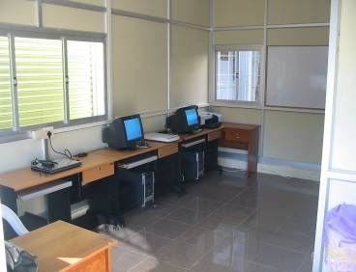


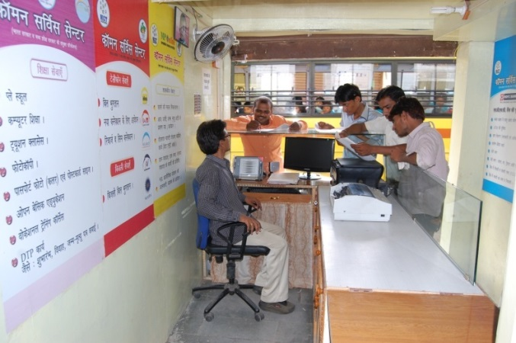
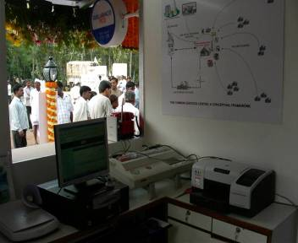


CSC Infrastructure
100 – 150 sq. ft space
Minimum 1 PC with UPS
Minimum 1 Printer
Digital / Web Camera
Genset / Inverter/ Solar
OS and other application software
Broadband Connectivity
Trained and incentivized manpower
Enabled with PC(s), printer(s), scanner(s), UPS, digital/web camera & broadband connectivity. Additional equipment in the form of projection systems, biometric devices, etc., may be included, as and when required

Slide 17


CSC Service Portfolio
B2C Services
G2C Services
Electricity Bill collection in various states
Data Card Recharge
DTH Recharge
CSC Bazaar – e commerce/shopping service
Mobile Bill Payments
Mobile Recharge
E learning
Premium Collection
Insurance
Travel – IRCTC/AIR Tickets/Bus Bookings
Brilliants- medical/IAS/IIT/Banking courses
Online Training
CSC Rozgar
Election Commission of India (EC) Services
Unique identification Authority of India (UIDAI) Services
Passport Services
Banking Correspondent (27 banks)
National Institute of Open Schooling (NIOS) services
PAN Card Services
Pension Fund Regulatory Development Authority (PFRDA) services
NIELIT services
Agricultural Services
Health Care Services
State e district/SSDG services

Slide 18




UIDAI Services
Aadhaar enrolment
eAadhaar Printing
Demographic Data Update
Biometric Data Update
Database Seeding
Best Finger Detection
Authentication User Agency
Authentication Service Agency
CSC SPV is now ranked 2nd in the country wide UID Registrar Ranking.
No. of PECs - 14591
During April, 2015 to February, 2016 have earned total revenues of Rs 262.44 lakh
A total 606 lakh Aadhaar Enrollments have taken place at the PECs.
A total of 1.43 Crore E-KYC have been done during April, 2015 to February, 2016 pan India through CSC Network.
A total of 10.81 Crore Aadhaar Authentications have been conducted through CSCs during April, 2015 to February, 2016.
VLE are earning about Rs. 30,000+ per month from Aadhaar enrolment

Slide 19

Financial Inclusion - Banking
Department of Financial Services issued guidelines to all the Public Sector Banks on 20th December, 2012 regarding engagement of CSCs as BCAs. With the launch of Pradhan Mantri Jan-Dhan Yojna (PMJDY) in August, 2014, the CSCs as Bank Mitr / Banking Correspondent Agent (BCA) at the Gram Panchayat level have now become the extended arm of the Banks. These BCAs have a vital role in successful implementation of Financial Inclusion and PMJDY.
CSC SPV as a corporate Banking Correspondent has signed agreement with 42 Banks (Public Sector Banks, Regional Rural Bank and Private Sector Banks) for enabling CSCs to become Banking Correspondent Agents / Customer service points that deliver various banking and financial services in a number of States across the country.
Products offering
Banking Services
Enrollment of customers, including collection of biometric & other details, provide card (ID Card, Debit, Card, Credit Card, PIN)
Transaction facility like Deposit & Withdrawal of money in an account with a bank, Balance Enquiry & issue Receipts/ Statement of Accounts.
Remittances from an account with a bank to an account with the same
Disbursal of credit facilities to borrowers involving small amounts strictly as per the instructions of the Bank
No Frills Savings Bank account
Recurring Deposit Accounts
Remittances
Fixed Deposit / Overdraft / Retail loans
KCC/GCC
Third party financial products (with prior approval of the concerned Bank)

Slide 20
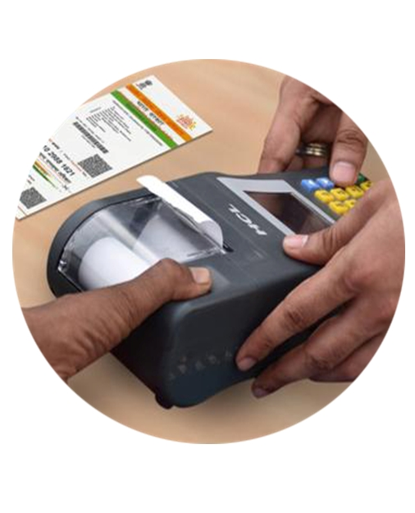
Financial Inclusion Banking- AEPS
Aadhaar Enabled Payment System- INTEROPERABLE FI GATEWAY SERVICES
AEPS is a bank led model which allows online interoperable financial inclusion transaction at PoS (Micro-ATM) through the Business correspondent of any bank using the Aadhaar authentication.
The four Aadhaar enabled basic types of banking transactions are-
Balance Enquiry
Cash Withdrawal
Cash Deposit
Aadhaar to Aadhaar Funds Transfer
The only inputs required once for a customer to do a transaction under this scenario are:-
IIN (Identifying the Bank to which the customer is associated)
Aadhaar Number
Fingerprint captured during their enrollment

Slide 21


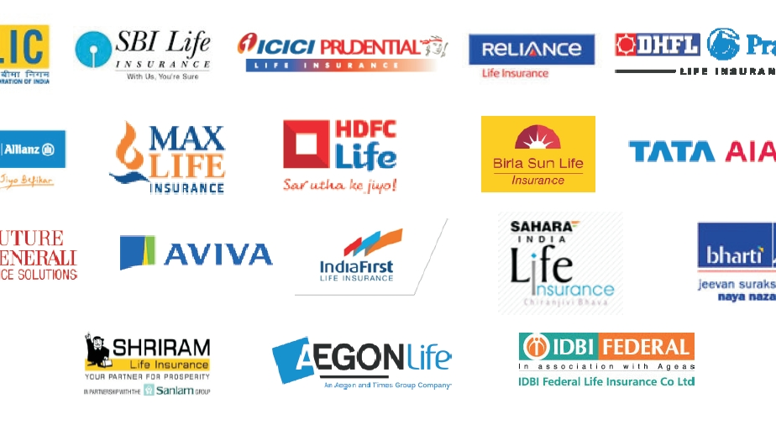
Financial Inclusion Insurance
Insurance Regulatory and Development Authority (IRDA) granted License to CSC e-Governance Services India Limited to work as an Authorized Intermediary to market specifically approved insurance products through the Rural Authorised Persons (Village Level Entrepreneurs) under the CSC Scheme of National e-Governance Plan under the IRDA Guidelines on Common Services Centres, 2013. The License permits both Life and Non Life Insurers in India to Market Retail Insurance products and Services through Common Service Centres Network.
In order to streamline the Insurance work flow a new domain http://insurance.csc.gov.in/ has been launched by CSC e- Governance Services India Ltd in the month of August 2015. As per the new flow the entire RAP Flow is divided into five steps which are as follows –
(i) RAP Registration (ii) Fee Payment (iii) VLE Information Update
(iv) Insurance Training (v) Online Insurance Examination

Slide 22
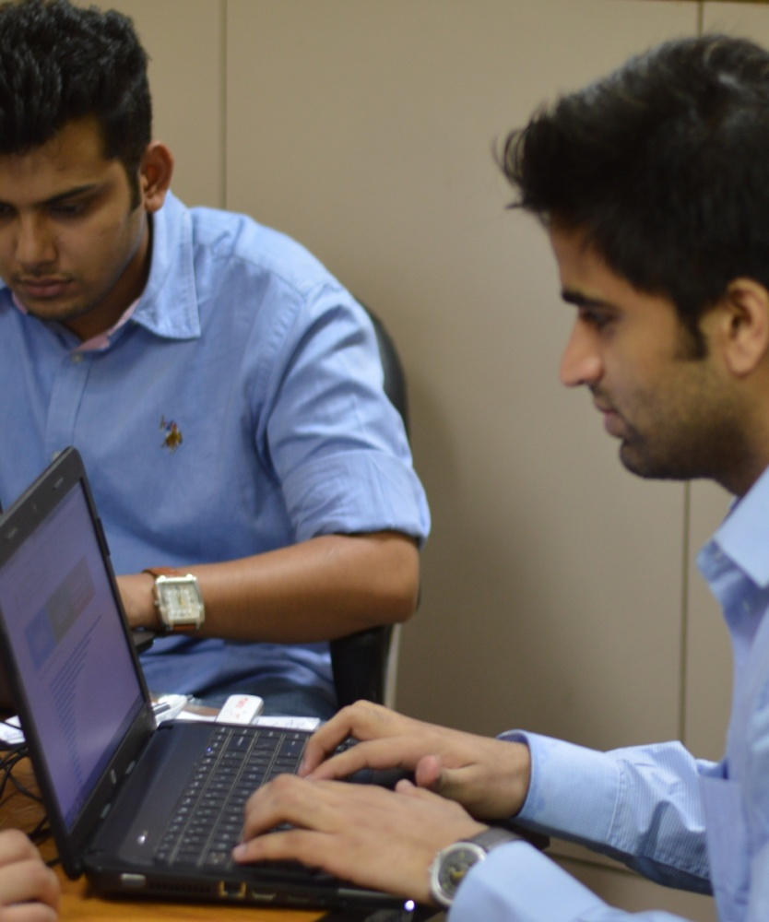
Education
IT Mass Literacy Programme- during September, 2014 to February, 2016, a total of 50,99,123 persons have been registered under this Programme, while a total of 38,30,327 persons have been trained under this Programme.
NDLM (Phase-I)
The Scheme- Department of Electronics & Information Technology (DeitY), Ministry of Communication & Information Technology, Government of India introduced the National Digital Literacy Programme in the year 2014 -- Scheme for IT Mass Literacy. The first phase of the Programme called National Digital Literacy Mission (NDLM) introduced in March, 2014 was to provide e-literacy relevant to the need of the trainee to 10 lakh (ten lakh) persons in selected blocks in each State/UT by covering one person from every household where no digitally literate person is available, which would enable the beneficiaries to use IT and related applications to participate effectively in the democratic process and enhance their livelihood.
Achievements from September, 2014 to February, 2016, in total 10,63,747 persons have been registered under this Programme.

Slide 23

Education
Contd
CYBER GRAM YOJANA
The Cyber Gram Yojana is part of the Multi-Sectoral Development Programme (MsDP) launched by the Ministry of Minority Affairs, Government of India. CSC e-Governance Services India has been engaged as the national implementing Agency of the Programme. The programme is currently being implemented in West Bengal, Rajasthan and Tripura.
A total of 1,09,848 students have been registered under this Programme till February, 2016 in these 3 (three) States, while till February, 2016, in total 94,814 students from these 3 (three) States have completed their training under this Programme.
COURSE ON COMPUTER CONCEPTS FOR VLES (VLE CCC)
In order to impart basic IT training to 100,000 VLEs, the Department of Electronics and Information Technology (DeitY) started the 80 hour Course on Computer Concepts (CCC) through the National Institute of Electronics & Information Technology (NIELIT) in 2010. The said course is still continuing.
During April, 2015 to February, 2016, in total 37,171 VLEs have registered in this course out of which 13,868 VLEs have appeared in the exam, out of them 6,883 VLEs have cleared the test during April, 2015 to February, 2016.
OTHER EDUCATIONAL SERVICES
The following education services are currently being offered through the network of CSCs.
NIELIT
NIOS
GOLS
CSC SPV’s own Basic Computer Course (BCC)

Slide 24
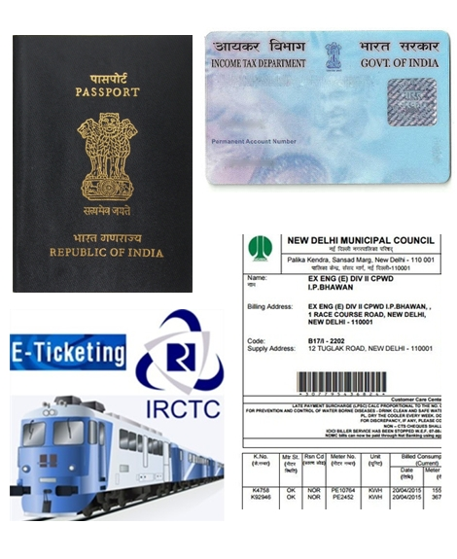
G2C Services
IRCTC SERVICES
April, 2015 to February, 2016, in total 40,945 transactions have happened through CSC Network for reservation in AC classes involving transactions value of Rs 837.95 lakh. From April, 2015 to February, 2016, in total 2,75,992 transactions have happened through CSC Network for reservation booking in non-AC Classes with the total transaction value of Rs 2,255.54 lakh
PASSPORT SERVICES
The Ministry of External Affairs, along with CSC e-Governance Services India Limited, has launched Passport related services through the vast network of over one lakh Common Services Centres (CSCs) across rural hinterland. Under the Passport Seva, the Ministry has made it mandatory to complete the entire form filing process on-line, including payment of applicable fee and scheduling of appointment for seeking Passport related services.
PAN CARD SERVICES
PAN Card service is live on CSC India Online Portal. The UTI ITSL portal for Pan Card Service and the CSC India Online portal has been integrated to offer seamless delivery of PAN Card services to citizens through CSCs. Presently only new applications of Pan requests are taken. A new Pan card to rural citizens is made available at a cost of Rs 106/- through Common Services Centres.
ELECTRICITY BILL AND OTHER UTILITY BILL PAYMENT
CSC e-Governance Services India Limited entered into agreement with the Electricity Distribution Corporations of various States/Union Territories for collection of electricity consumption bills through CSC Network. Till February, 2016, system integration for payment of electricity bills through CSC network on Apna CSC Portal has been put in place in 10 States and 1 Union Territory.

Slide 25


Skill Development
CSC SPV has launched skill development initiatives in various sectors to provide market-oriented skills to the rural youth in order to enhance their employability and improve livelihood options. Some of the services are:
Partnership with NSDC STAR Scheme - Tie-up for Agricultural & Automotive Skill Council of India to start the skill development programme in Paddy Farming and Motor Cycle Mechanic
Construction Skill Training
Skill Based Services- Tie-up with Siemens and Hero Motocorp for Assistant Motor Mechanic Training course.
Rozgar Duniya- “Rozgar Duniya portal” as a service has been launched for job seekers to register themselves with this portal.

Slide 26

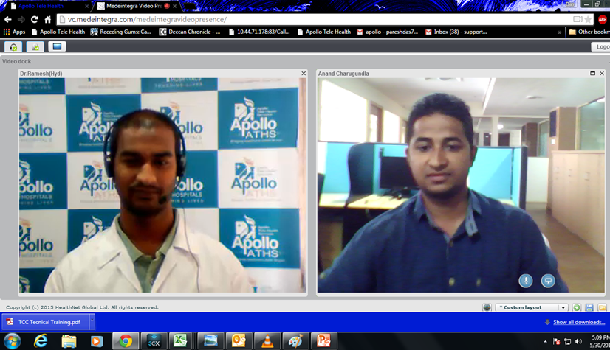
Healthcare- SEHAT
Social Endeavour in Healthcare and Telemedicine
CSC Health Services endeavours to provide quality healthcare solutions like tele-medicine, diagnostic services and generic medicine services to the masses in rural and remote areas of the country, through the vast network of CSCs.
Apollo Tele Health services- activated in 10,000 CSCs.
Effective healthcare service delivery at the grassroots through high quality diagnostic services like BP monitoring, Blood Glucose, ECG, pregnancy tests, etc. through select network of CSCs in pilot phase.
Tele- opthalmology- initiative piloted in 10 select CSCs in Alwar (Rajasthan) and Ghaziabad (Uttar Pradesh) in collaboration with Venu Eye Institute to deliver primary eye care to rural masses.
CSCs to extend quality generic medicines and health awareness to the rural population throughJan Aushadi Stores under the Jan Aushadhi Scheme.

Slide 27

E-commerce
enabling sale, purchase and last mile delivery network
CSC SPV in association with e-Commerce partners is enabling sale, purchase and last mile delivery network to offer a level playing field for rural markets. Hon’ Union Minister of Communications and IT Shri Ravi Shankar Prasad inaugurated this service to create a platform to enhance rural entrepreneurship through CSCs. Some of the key benefits are:
To help facilitate augmentation of economic activities in CSCs & enhance revenue generation among CSCs
To make CSCs a hub of economic activity in their respective areas of operation, with emphasis on building network in rural areas of India
Facilitate economic development of ancillary industries, such as handicrafts, textile, local specialties, packaging, logistics etc. around the CSC
To increase employment in rural areas thereby reducing the migration of people from rural to urban areas
To facilitate the MSME’s in rural areas to sell their products across the country without the necessity of brand /marketing experience or showrooms
To assist rural India in buying products from e-commerce websites
To support local entrepreneurs from rural areas in uploading and selling their products on e-Commerce websites like Amazon, e-Bay, Flipcart, Snapdeal and Infibeam

Slide 28
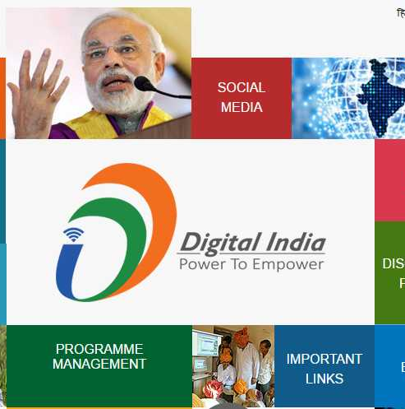
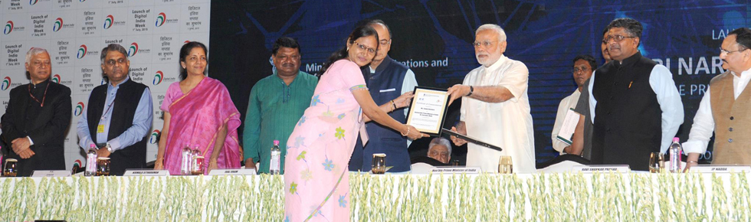

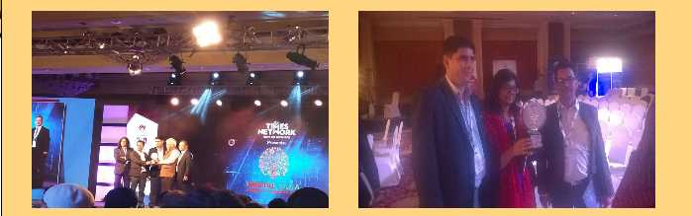
awards
Awards and honours
Tanuja Raichuria - honored for their exemplary work in Digital India initiative. Tanuja was honored due to her efforts in imparting digital knowledge to the villagers and providing various digital facilities to villagers through an ICT enabled Common Service Center (CSC) in Dhamtari ,Chhattisgarh
CSC SPV has bagged this year’s Digital India Summit Award for Best Innovation in e-Education Learning Solutions under the Good for India category at a gathering of technology and innovation leaders and influencers on March 22, 2016 at New Delhi. The award, instituted by Times Network and ET Now,

Slide 29
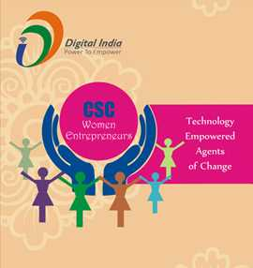
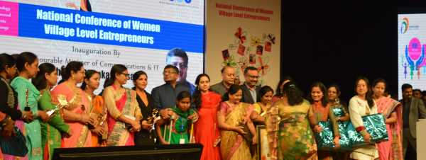

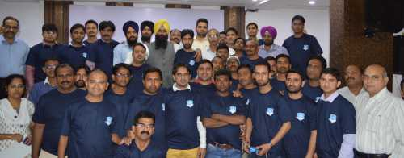
awards
Awards and honours
Hon’ Minister for Communications and IT, Shri Ravi Shankar Prasad - recognizing the contributions made by CSC Women entrepreneurs in empowering communities.
Some of the best performing VLEs from across the country gathered together for training on the ICT enabled services in master VLE Workshop

Slide 30
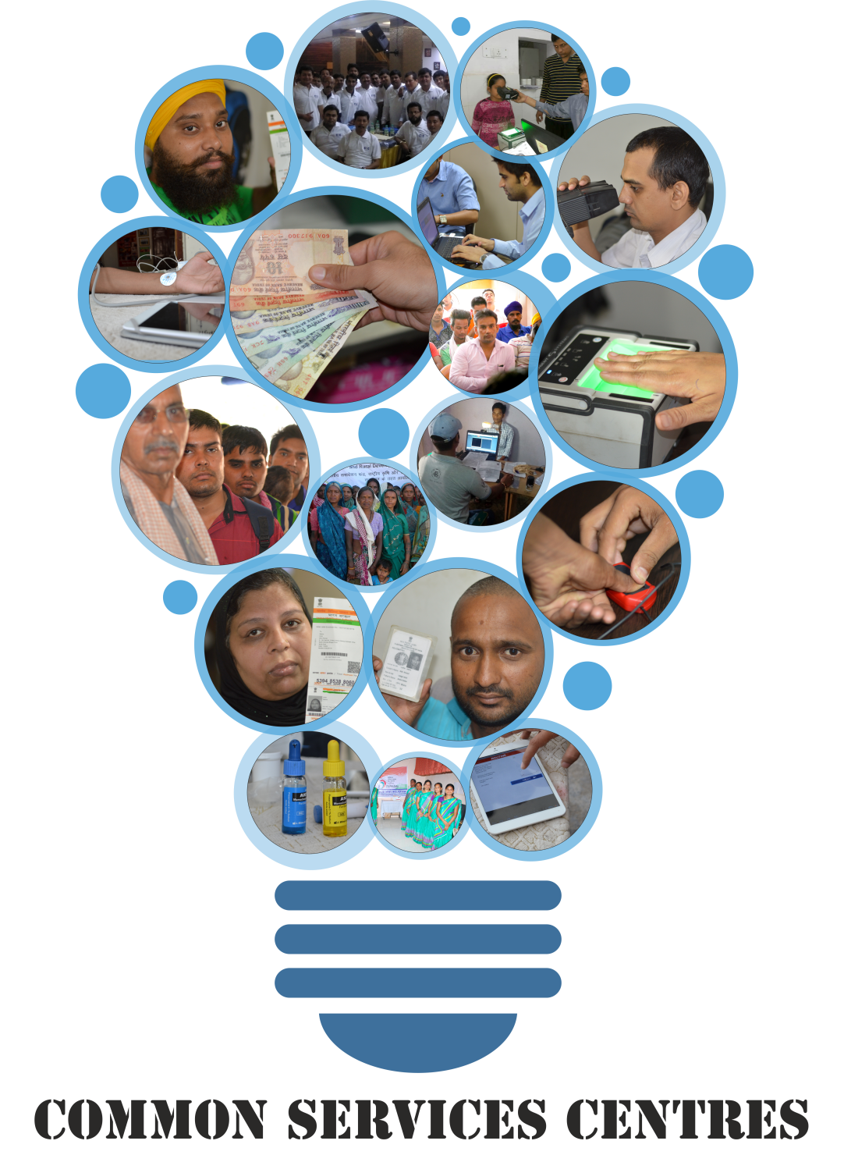
THANK YOU FOR LISTENING!
Time for Discussion & Questions
www.facebook.com/cscscheme
https://twitter.com/CSCegov_
www.csc.gov.in

Slide 31
Highlights
No. of CSC Rolled out till January, 2016 : Total – 1,56,217 : In GP - 1,03631. Rolled out in January, 2016 : 4,071 including 3,420 CSCs in Gram Panchayats.
As on 31 January, 2016, CSCs have been set up in 53 Rural Post Offices.
As on 31 January, 2016, estimated No. of GP Connected - 161,360 and NOFN is connected to 4068 GP, while 482 CSCs are collocated with NOFN connections.
April, 2015 – January, 2016, the volume of Transactions has been 888.73 lakh pan India.
April, 2015 to January, 2016, in total 3,26,560 applications have been filed for PAN Card through CSCs.
April, 2015 to January, 2016, in total 1,14,146 Application for Indian Passport have been filed through CSC Network.
During January, 2016, a total of 14,330 Permanent Enrollment Centres delivered Aadhaar Services. April, 2015 to January, 2016 in total 550 lakh Enrollment for Aadhaar Numbers have happened through CSC Network.
April, 2015 to January, 2016, in total 525 lakh Aadhaar Numbers have been generated through CSC Network.
122.66 lakh E-KYC have been done during April, 2015 to January, 2016 through CSC Network.
April, 2015 to January, 2016 in total 1006.80 lakh Authentication have been done through CSC Network.
April, 2015 to January, 2016, in total around 22.21 lakh Aadhaar PVC Cards have been printed through CSC Network pan India.

Slide 32
Highlights
As on 31 January, 2016 in total 28,111 BCAs are approved pan India,during the period from April, 2015 to January, 2016 VLEs have earned total commission of Rs 4282.35 lakh from BC Points.
Authorised VLEs have collected Life Insurance Premium worth Rs 80.39 lakh for new Policies, while a sum of Rs 613.02 lakh has been collected by the authorised VLEs as General Insurance Premium till January, 2016.
RAP Registration as on 31 January, 2016 – 9532 RAP licences were issued to VLEs.
Till January, 2016 a total of 17,847 VLEs have collected Renewal Insurance Premium of around Rs 18,118.65 lakh from 5,89,742 customers.
In January, 2016, a total of 6.65 lakh persons have registered under NDLM through CSCs, while in total 43.61 lakh persons have been registered under this Programme till January, 2016. April, 2015 to January, 2016, in total 31.05 lakh persons have been trained under this Programme.
A total of 10.96 lakh persons have been certified by NIELIT.
A total of 1,04,589 Madrassa students have been registered for training under CyberGram Yojana
April, 2015 – January, 2016, in total 12,46,135 EPICs were printed through the same window.
As on 31 January, 2016, a total of 8,291 VLEs have been providing IRCTC services. During January, 2016, a total of 37,641 transactions for Railway Reservation have been done, while during April, 2015 to January, 2016 in total 2,76,457 transactions for railway reservation have been done by CSCs.

